Slide 1
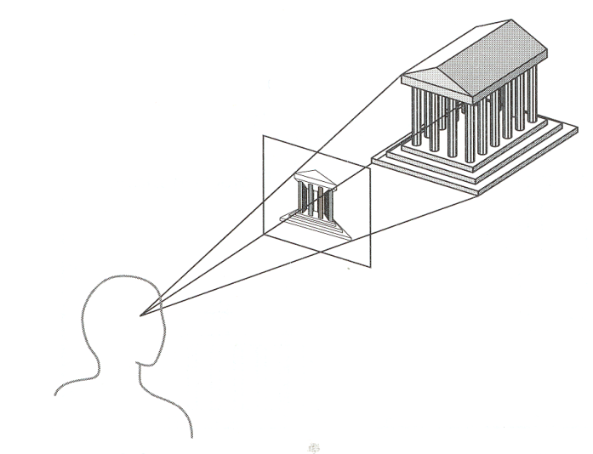
CSE 409:
Computer Graphics
Camera Transformations and Projection
Angel: Interactive Computer
Graphics
Acknowledgements: parts of information and pictures has been collected from the University of Virginia.

Slide 2
Projection
In general, projections transform points in a coordinate system of dimension n into points in a coordinate system of dimension less than n.
We shall limit ourselves to the projection from 3D to 2D.
We will deal with planar geometric projections where:
  The projection is onto a plane rather than a curved surface
  The projectors are straight lines rather than curves

Slide 3
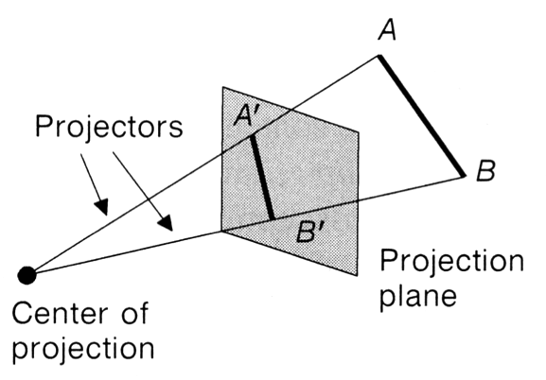
Projection
key terms…
  Projection from 3D to 2D is defined by straight projection rays (projectors) emanating from the 'center of projection', passing through each point of the object, and intersecting the 'projection plane' to form a projection.

Slide 4
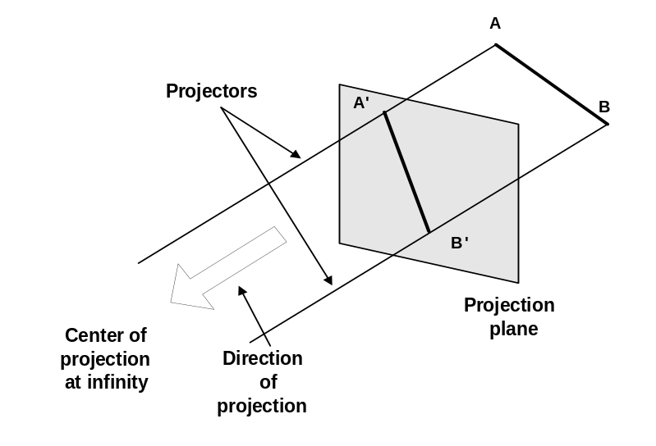
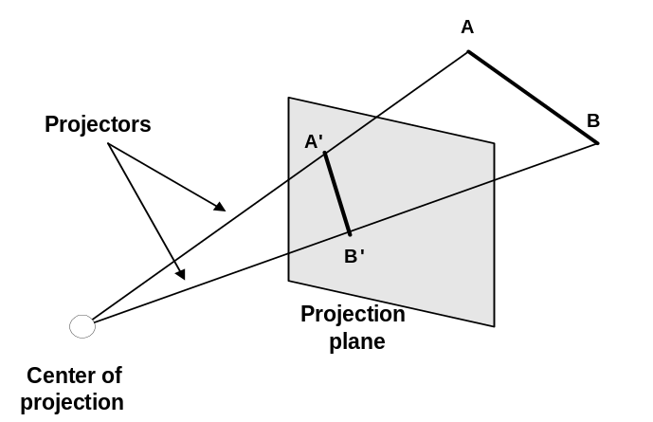
Planer Geometric Projection
2 types of projections
  perspective and parallel.
Key factor is the center of projection.
  if distance to center of projection is finite : perspective
  if infinite : parallel
Perspective projection
Parallel projection

Slide 5
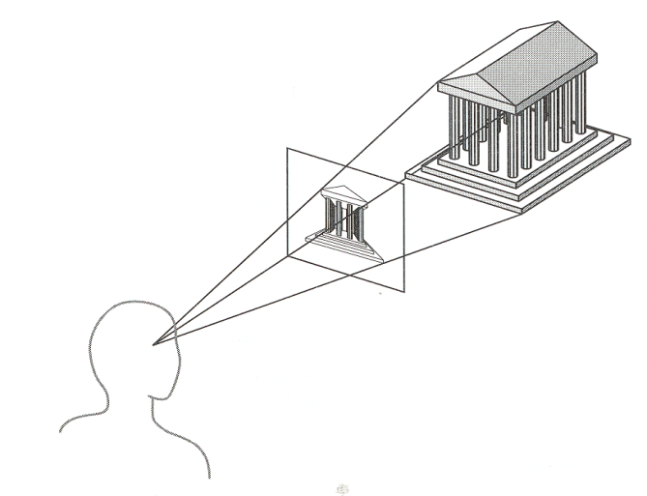
Perspective v Parallel
Perspective:
  visual effect is similar to human visual system...
  has 'perspective foreshortening'
    size of object varies inversely with distance from the center of projection.
  Parallel lines do not in general project to parallel lines
  angles only remain intact for faces parallel to projection plane.

Slide 6
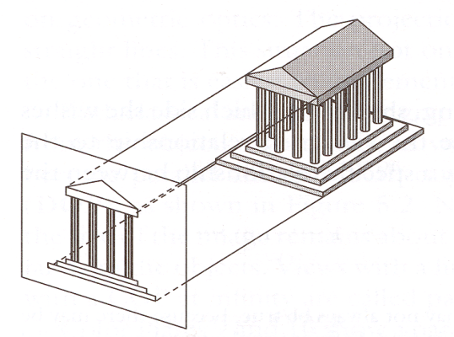
Parallel
Parallel:
  less realistic view because of no foreshortening
  however, parallel lines remain parallel.
  angles only remain intact for faces parallel to projection plane.

Slide 7
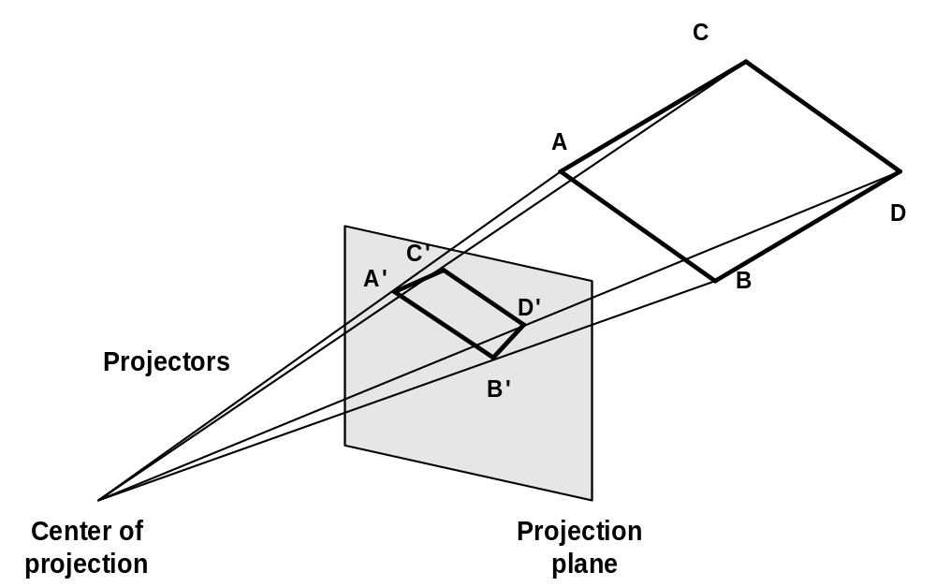
Perspective projection- anomalies
Perspective foreshortening The farther an object is from COP the smaller it appears

Slide 8
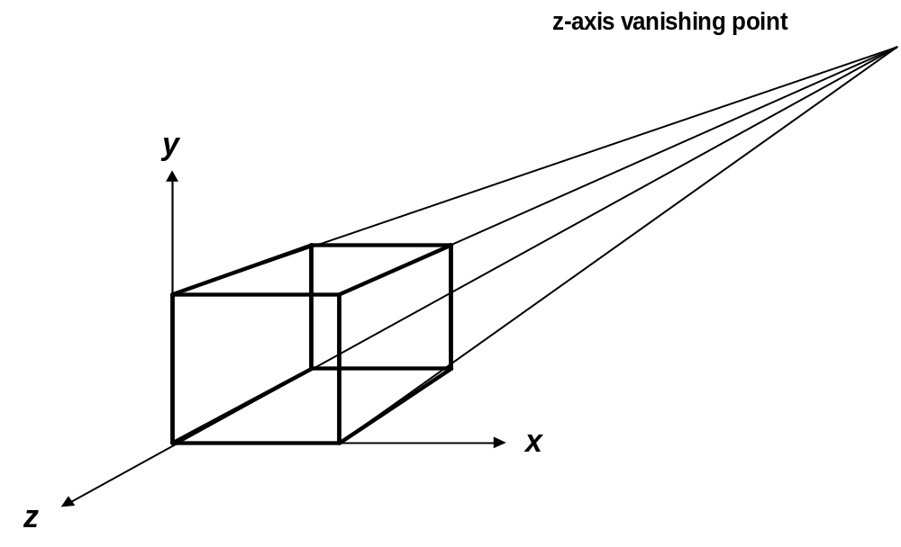
Perspective projection- anomalies
Vanishing Points: Any set of parallel lines not parallel to the view plane appear to meet at some point.
  There are an infinite number of these, 1 for each of the infinite amount of directions line can be oriented
Vanishing point

Slide 9

Vanishing Point

Slide 10
Vanishing Point
If a set of lines are parallel to one of the three axes, the vanishing point is called an axis vanishing point (Principal Vanishing Point).
  There are at most 3 such points, corresponding to the number of axes cut by the projection plane
One-point:
  One principle axis cut by projection plane
  One axis vanishing point
Two-point:
  Two principle axes cut by projection plane
  Two axis vanishing points
Three-point:
  Three principle axes cut by projection plane
  Three axis vanishing points

Slide 11
Vanishing Point

Slide 12
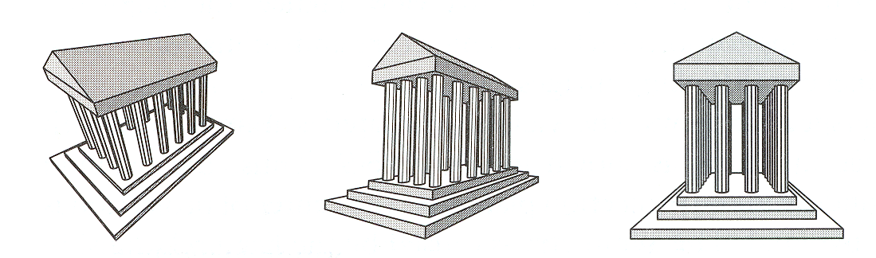
Perspective Projection
How many vanishing points?
3-Point
Perspective
2-Point
Perspective
1-Point
Perspective
Angel Figure 5.10

Slide 13
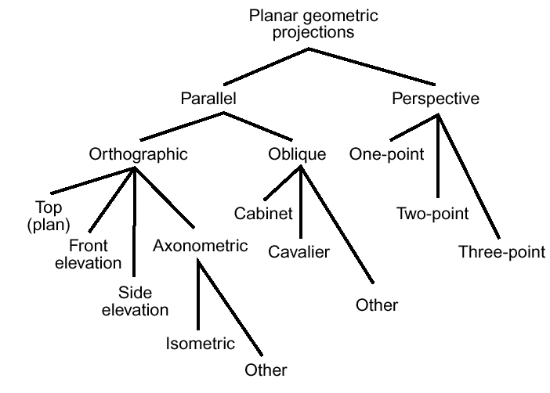
Taxonomy of Projection XM

Slide 14

Parallel projection
2 principle types:
  orthographic and oblique.
Orthographic :
  direction of projection = normal to the projection plane.
Oblique :
  direction of projection != normal to the projection plane.

Slide 15
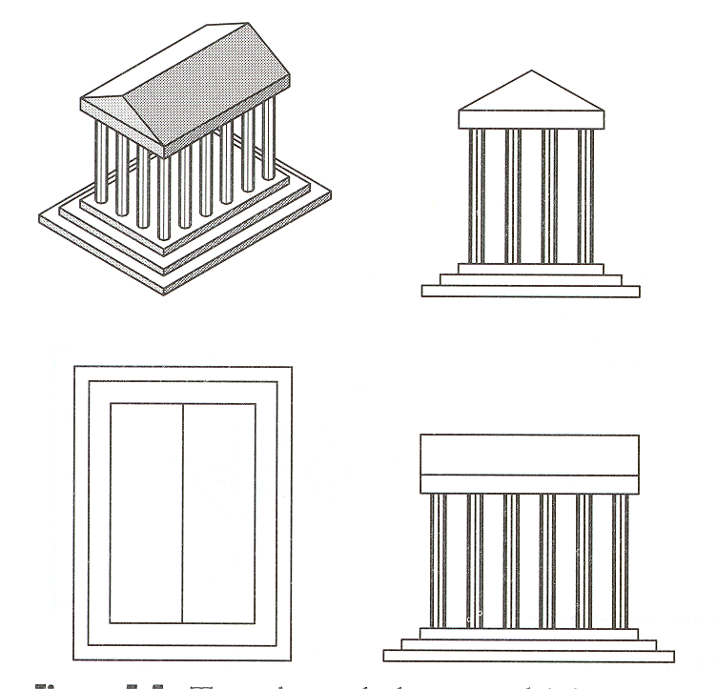
Orthographic Projections
DOP perpendicular to view plane
Top
Front
Side

Slide 16
Axonometric Orthogonal Projection
Projection plane are not normal to the principle axis and therefore show several faces of an object at once.
(XM) Isometric Axonometric Orthogonal Projection: Projection plane normal makes equal angles with each principle axis. If the projection plane normal is (d_{x}, d_{y}, d_{z}) then
| d_{x} | = | d_{y} | = | d_{z} |. There are 8 directions to satisfy this condition.

Slide 17



Axonometric vs Perspective
Axonometric projection shows several faces of an object at once like perspective projection.
But the foreshortening is uniform rather than being related to the distance from the COP.
Isometric proj
Projection Plane

Slide 18
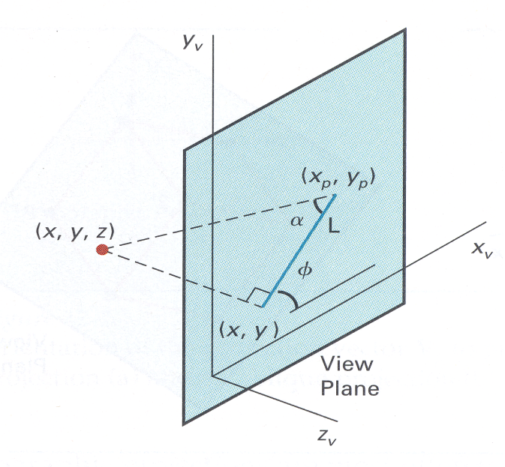
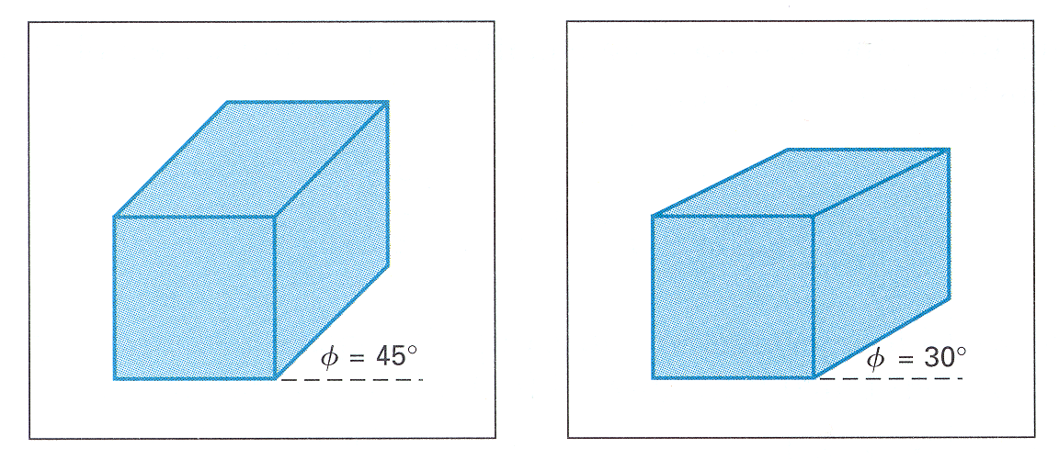
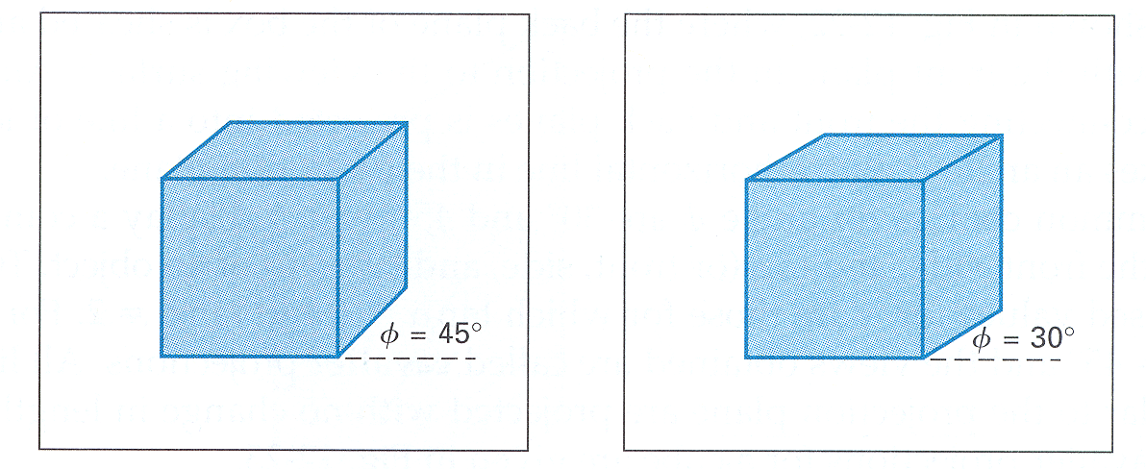


Oblique Projections
DOP not perpendicular to view plane
Cavalier
(DOP α = 45º)
tan(α) = 1
Cabinet
(DOP α = 63.4º)
tan(α) = 2
H&B

Slide 19
Oblique parallel projection
Cavalier, cabinet and orthogonal projections can all be specified in terms of (α, β) or (λ ,β) since
  tan(α) = 1/λ
λ sin(β)
P׳(λ cos(β), λ sin(β),0)
α
λ
P=(0, 0, 1)
β
λ cos(β)

Slide 20
Oblique parallel projection
λ=1 | α= 45 | Cavalier projection | β= 0 - 360
λ=0.5 | α = 63.4 | Cabinet projection | β= 0 – 360
λ=0 | α = 90 | Orthogonal projection | β= 0 – 360

Slide 21




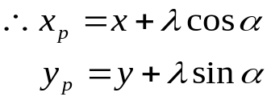
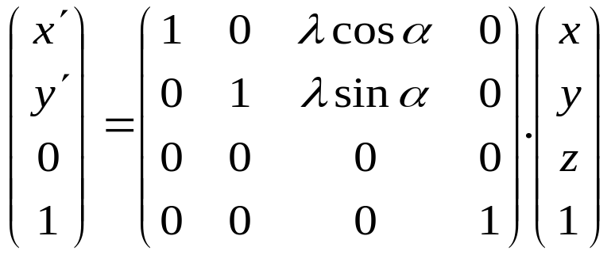
Oblique parallel projection
PP‘ = (λ cos(α), λ sin(α),-1) = DOP
Proj(P) = (λ cos(α), λ sin(α),0)
Generally
  multiply by z and allow for (non-zero) x and y
x ‘ = x + z λcos α
y‘ = y + z λsin α
Replace α by β for this slide

Slide 22
Taxonomy of Projection

Slide 23
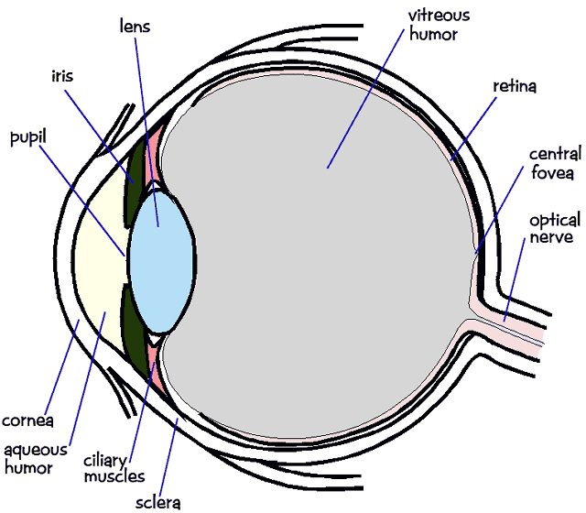
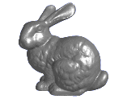
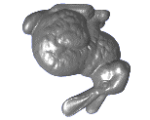
Perspective Projection
In the real world, objects exhibit perspective foreshortening: distant objects appear smaller
The basic situation:

Slide 24
Perspective Projection
When we do 3-D graphics, we think of the
screen as a 2-D window onto the 3-D world:
How tall should
this bunny be?

Slide 25
Perspective Projection
The geometry of the situation is that of similar triangles. View from above:
What is x’ ?
X
View
plane
P (x, y, z)
(0,0,0)
x’ = ?
Z
d

Slide 26
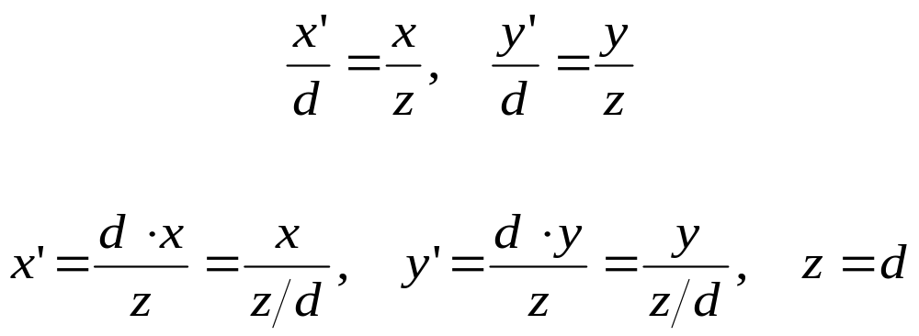
Perspective Projection
Desired result for a point [x, y, z, 1]^{T} projected onto the view plane:
What could a matrix look like to do this?

Slide 27
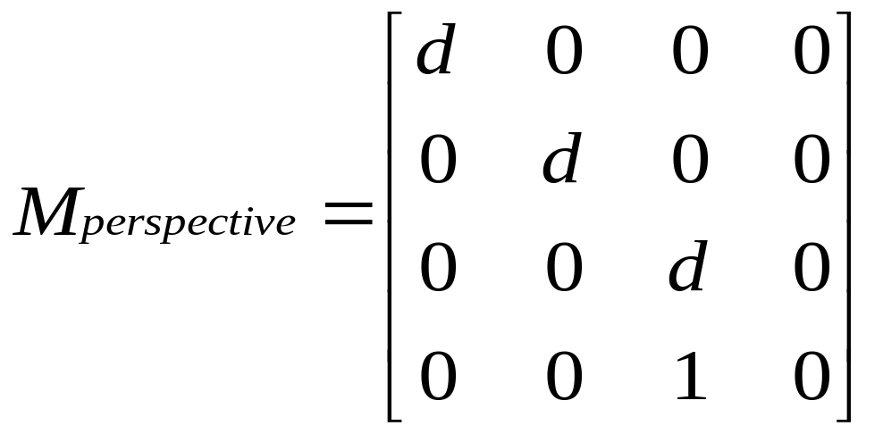
A Perspective Projection Matrix
Answer:

Slide 28
Generalized Projection
Using the origin as the center of projection, derive the perspective transformation onto the plane passing through the point R₀(x₀, y₀, z₀) and having the normal vector N = n₁I + n₂J + n₃K.
N = n₁I + n₂J + n₃K
R₀=(x₀ ,y₀, z₀)
y
P(x, y, z)
P'(x', y', z')
O
x
z

Slide 29
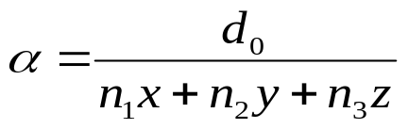
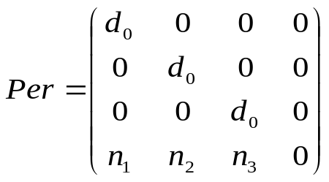
Generalized Projection
N = n₁I + n₂J + n₃K
P'O = α PO
x' = αx, y' = αy, z ' = αz
R₀=(x₀ ,y₀, z₀)
y
P(x, y, z)
N. R₀P' = 0
n₁x ' + n₂y ' + n₃z '
=n₁x₀ + n₂y₀ + n₃z₀ = d₀
P'(x', y', z')
O
x
z

Slide 30
Generalized Projection
Derive the general perspective transformation onto a plane with reference point R₀ and normal vector N and using C(a,b,c) as the center of projection.
N = n₁I + n₂J + n₃K
R₀=x₀ ,y₀, z₀
y
P(x, y, z)
C
P'(x', y', z')
x
z

Slide 31
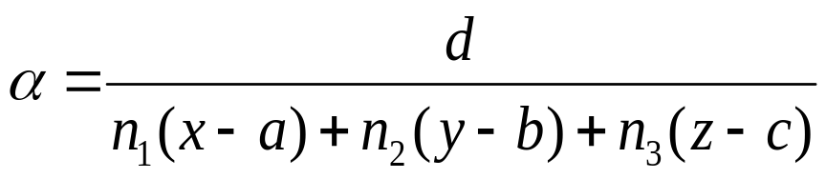
Generalized Projection
P'C = α PC
x' = α(x-a) + a
n₁x' + n₂y' + n₃z‘ = d₀
N = n₁I + n₂J + n₃K
R₀=x₀ ,y₀, z₀
y
d = (n₁x₀ + n₂y₀ + n₃z₀) – (n₁a + n₂b + n₃c)
= d₀ – d₁
P(x, y, z)
C
P'(x', y', z')
x
z

Slide 32
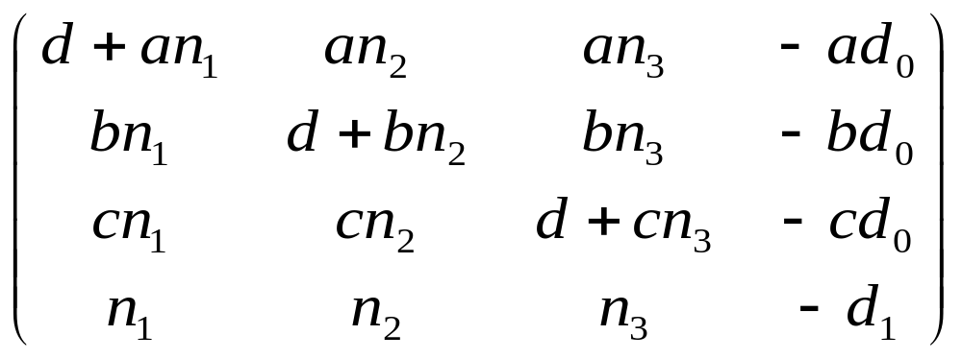
Generalized Projection
Follow the steps –
  Translate so that C lies at the origin
  Perform projection as the previous problem
  Translate back

Slide 33
Viewing in OpenGL
OpenGL has multiple matrix stacks - transformation functions right-multiply the top of the stack
Two most important stacks: GL_MODELVIEW and GL_PROJECTION
Points get multiplied by the modelview matrix first, and then the projection matrix
GL_MODELVIEW: Object->Camera
GL_PROJECTION: Camera->Screen
glViewport(0,0,w,h): Screen->Device

Slide 34
OpenGL Example
void SetUpViewing()
{
// The viewport isn’t a matrix, it’s just state...
glViewport( 0, 0, window_width, window_height );
// Set up camera->screen transformation first
glMatrixMode( GL_PROJECTION );
glLoadIdentity();
gluPerspective( 60, 1, 1, 1000 ); // fov, aspect, near, far
// Set up the model->camera transformation
glMatrixMode( GL_MODELVIEW );
gluLookAt( 3, 3, 2, // eye point
0, 0, 0, // look at point
0, 0, 1 ); // up vector
glRotatef( theta, 0, 0, 1 ); // rotate the model
glScalef( zoom, zoom, zoom ); // scale the model
}

Slide 35
Graphics Pipeline Revisited
3D Geometric Primitives
Modeling
Transformation
Viewing
Transformation
Projection
Transformation
Clipping
Lighting
Scan
Conversion
glMatrixMode( GL_MODELVIEW );
glLoadIdentity();
gluLookAt ( eyex, eyey, eyez,
lookx, looky, lookz,
upx, upy, upz );
Image

Slide 36
Default Camera Position
y
Eye
Near Plane
z
Far Plane
N
θ
x
F
glMatrixMode(GL_PROJECTION);
glLoadIdentity();
gluPerspective(viewAngle,
aspectRatio, N, F);

Slide 37
General Camera Position
v
Eye
n
u

Slide 38
General Camera Position
u
up
l = look - eye
r = l X up
l
look
u = r X l
eye
r
To transform world coordinate into camera’s coordinate, transform
  eye into the origin
  r into the vector i
  u into the vector j
  -l into the vector k
So what is the matrix for viewing transform?

Slide 39
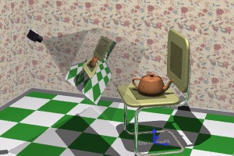
A 3D Scene
Notice the presence of
the camera, the
projection plane, and
the world
coordinate axes
Viewing transformations define how to acquire the image on the projection plane

Slide 40
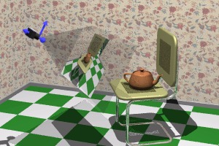
Viewing Transformations
Create a camera-centered view
Camera is at origin
Camera is looking along negative z-axis
Camera’s ‘up’ is aligned with y-axis

Slide 41

2 Basic Steps
Align the two coordinate frames by rotation

Slide 42

2 Basic Steps
Translate to align origins

Slide 43
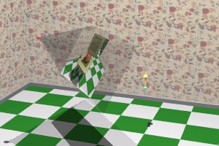
Creating Camera Coordinate Space
Specify a point where the camera is located in world space, the eye point
Specify a point in world space that we wish to become the center of view, the lookat point
Specify a vector in world
space that we wish to
point up in camera
image, the up vector
Intuitive camera
movement

Slide 44
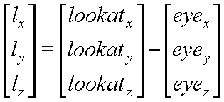

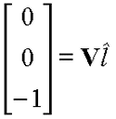
Constructing Viewing
Transformation, V
Create a vector from eye-point to lookat-point
Normalize the vector
Desired rotation matrix should map this
vector to [0, 0, -1]^{T} Why?

Slide 45

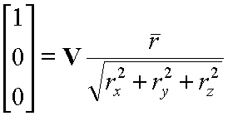
Constructing Viewing
Transformation, V
Construct another important vector from the cross product of the lookat-vector and the vup-vector
This vector, when normalized, should align with [1, 0, 0]^{T} Why?

Slide 46

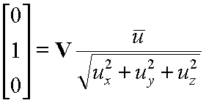
Constructing Viewing Transformation, V
One more vector to define…
This vector, when normalized, should align with [0, 1, 0]^{T}
Now let’s compose the results

Slide 47
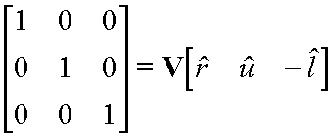
Compositing Vectors to Form V
We know the three world axis vectors (x, y, z)
We know the three camera axis vectors (r, u, l)
Viewing transformation, V, must convert from world to camera coordinate systems

Slide 48
Compositing Vectors to Form V
Remember
  Each camera axis vector is unit length.
  Each camera axis vector is perpendicular to others
Camera matrix is orthogonal and normalized
  Orthonormal
Therefore, M⁻¹ = M^{T}

Slide 49
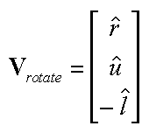
Compositing Vectors to Form V
Therefore, rotation component of viewing transformation is just transpose of computed vectors

Slide 50
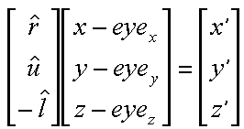
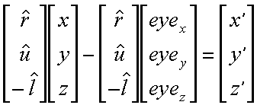
Compositing Vectors to Form V
Translation component too
Multiply it through

Slide 51
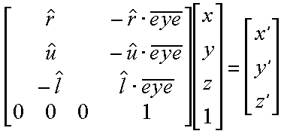
Final Viewing Transformation, V
To transform vertices, use this matrix:
And you get this:

Slide 52
Ref.
Chapter 7, Schaum's Outline of Computer Graphics (2nd Edition) by Zhigang Xiang, Roy A. Plastock

